Slide 1
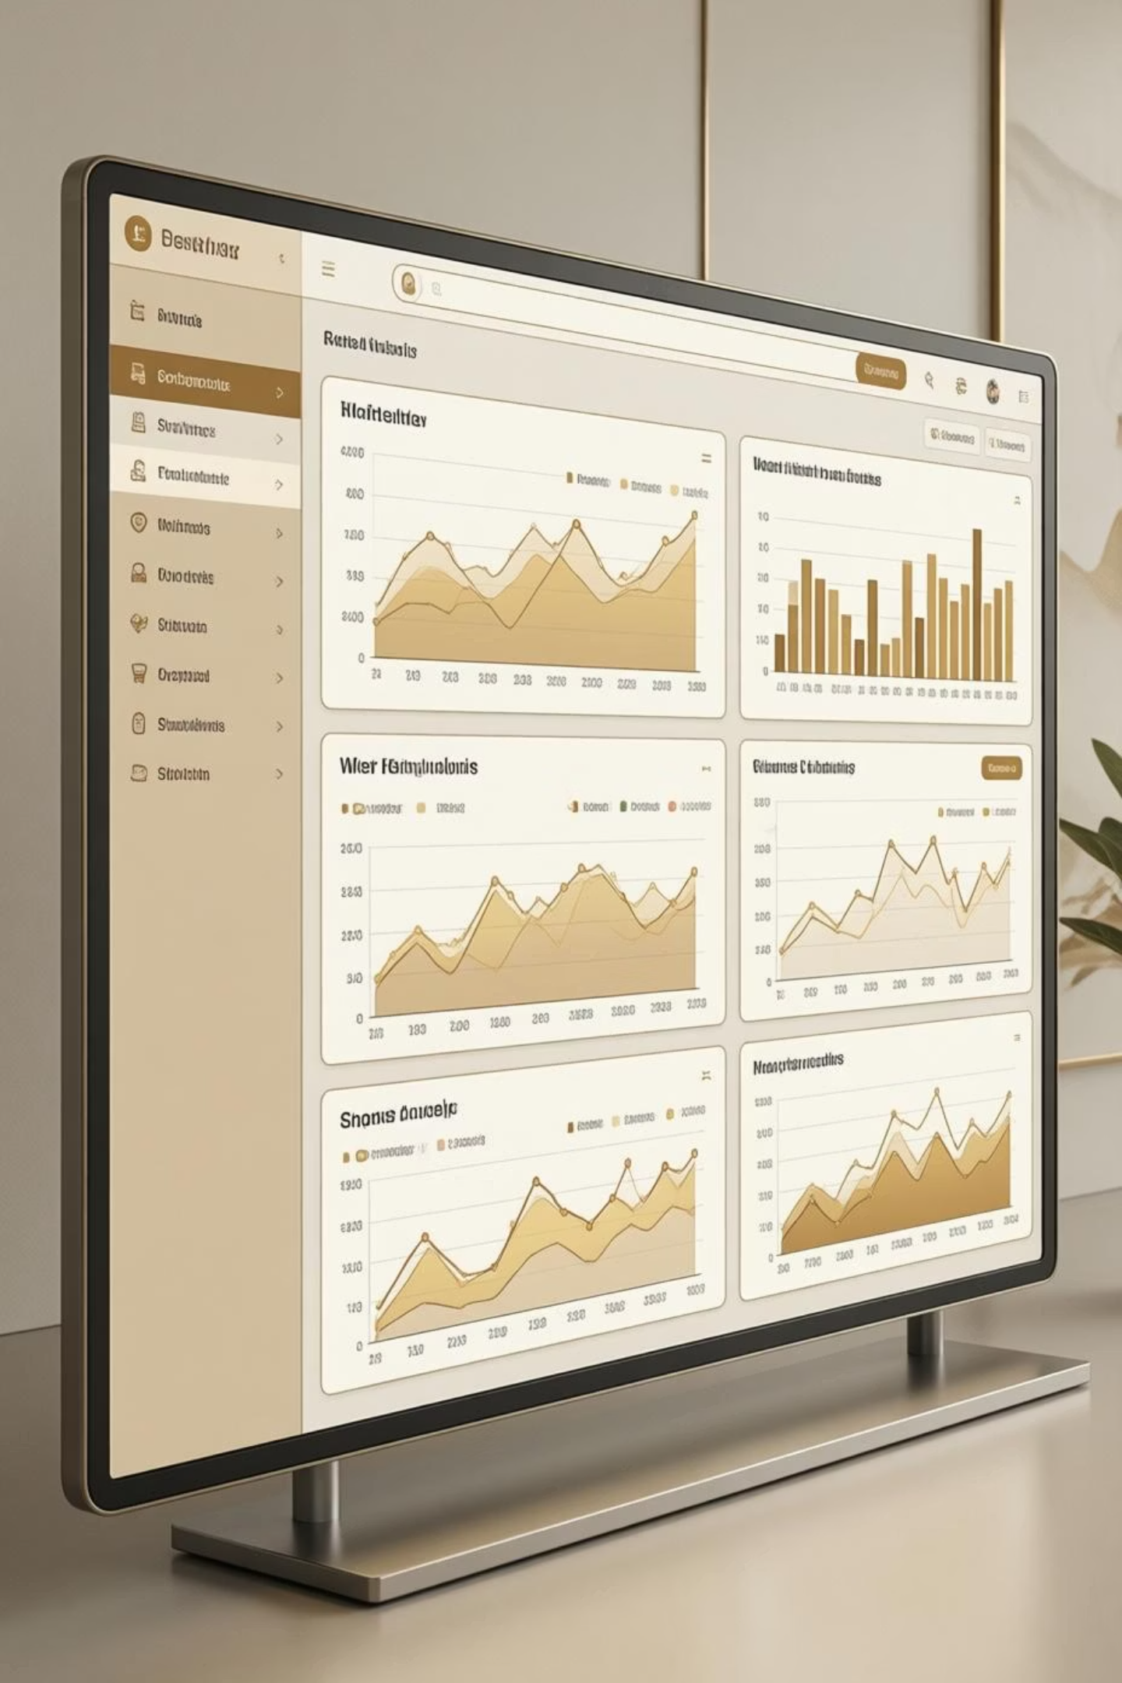
Customer Shopping Behavior Analysis
Uncovering insights from 3,900 purchases to guide strategic business decisions

Slide 2
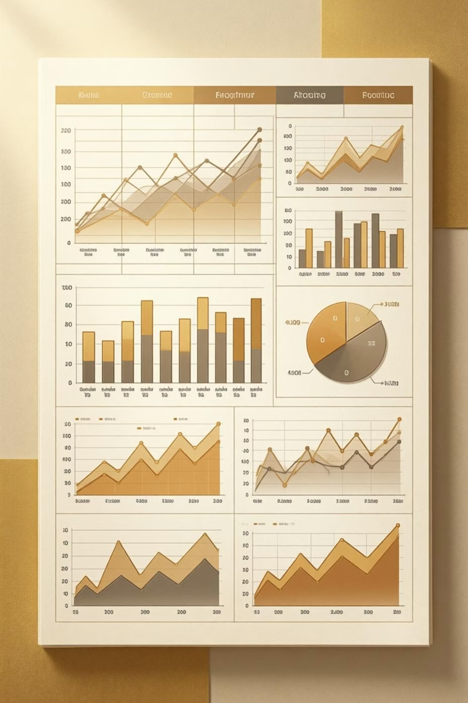

DATASET OVERVIEW
The Foundation
3,900
18
50
Total Purchases
Data Points
Locations
Transactions analyzed
Features per customer
Geographic coverage
25
Products
Items tracked

Slide 3
PYTHON ANALYSIS
Data Preparation & Cleaning
01
02
03
Data Loading
Exploration
Missing Data
Imported dataset using pandas
Structure check and summary statistics
Imputed 37 missing review ratings by category median
04
05
Feature Engineering
Database Integration
Created age groups and purchase frequency metrics
Loaded cleaned data into PostgreSQL

Slide 4



KEY METRICS
Customer Demographics
68%
Male Customers
2,652 shoppers
32%
Female Customers
1,248 shoppers
Average Age: 44 years (range 18-70)
Average Purchase: $59.76
Average Rating: 3.75 stars

Slide 5
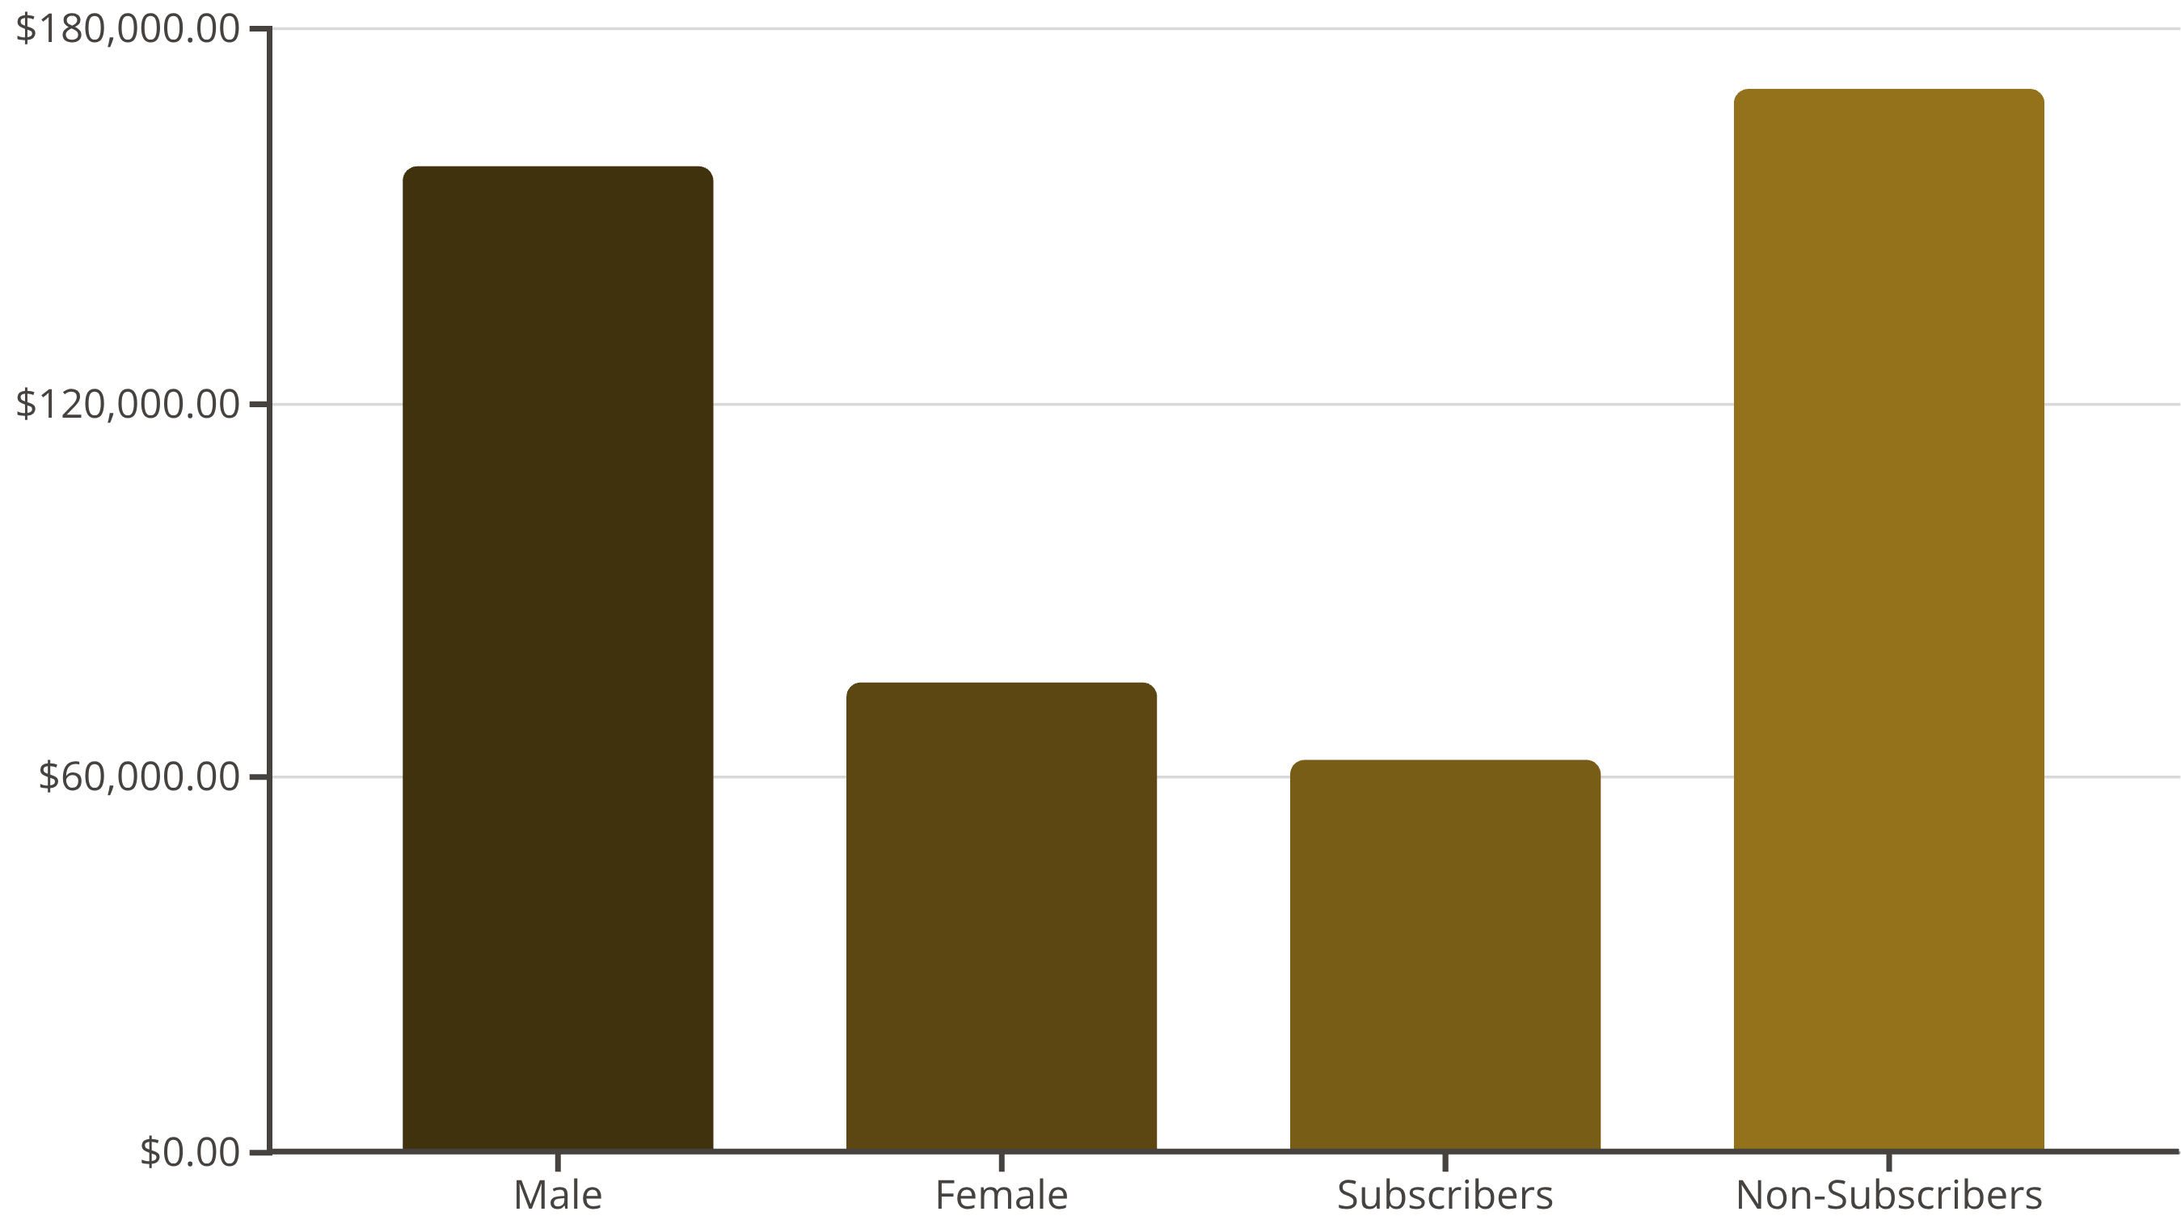
SQL INSIGHTS
Revenue Analysis
Male customers generate 68% of total revenue despite representing similar proportion of customer base

Slide 6

Product Performance
Top 5 Products by Rating
Gloves
3.86 average rating
Sandals
3.84 average rating
Boots
3.82 average rating
Hat
3.80 average rating
Discount Leaders
Skirt
Hat leads with 50% discount rate
3.78 average rating
Sneakers: 49.66%
Coat: 49.07%

Slide 7



SEGMENTATION
Customer Segments
Returning
701 customers
18% of customer base
Loyal
3,116 customers
80% of customer base
New
83 customers
2% of customer base

Slide 8
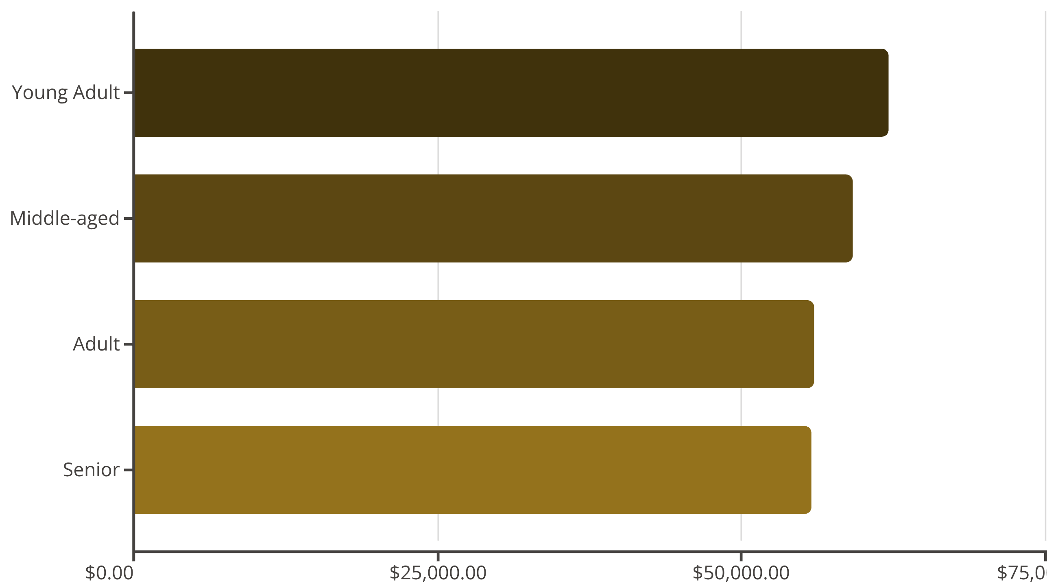
Revenue by Age Group
Young adults drive highest revenue despite relatively balanced distribution across age groups
Express Shipping: $60.48 avg
Standard Shipping: $58.46 avg

Slide 9
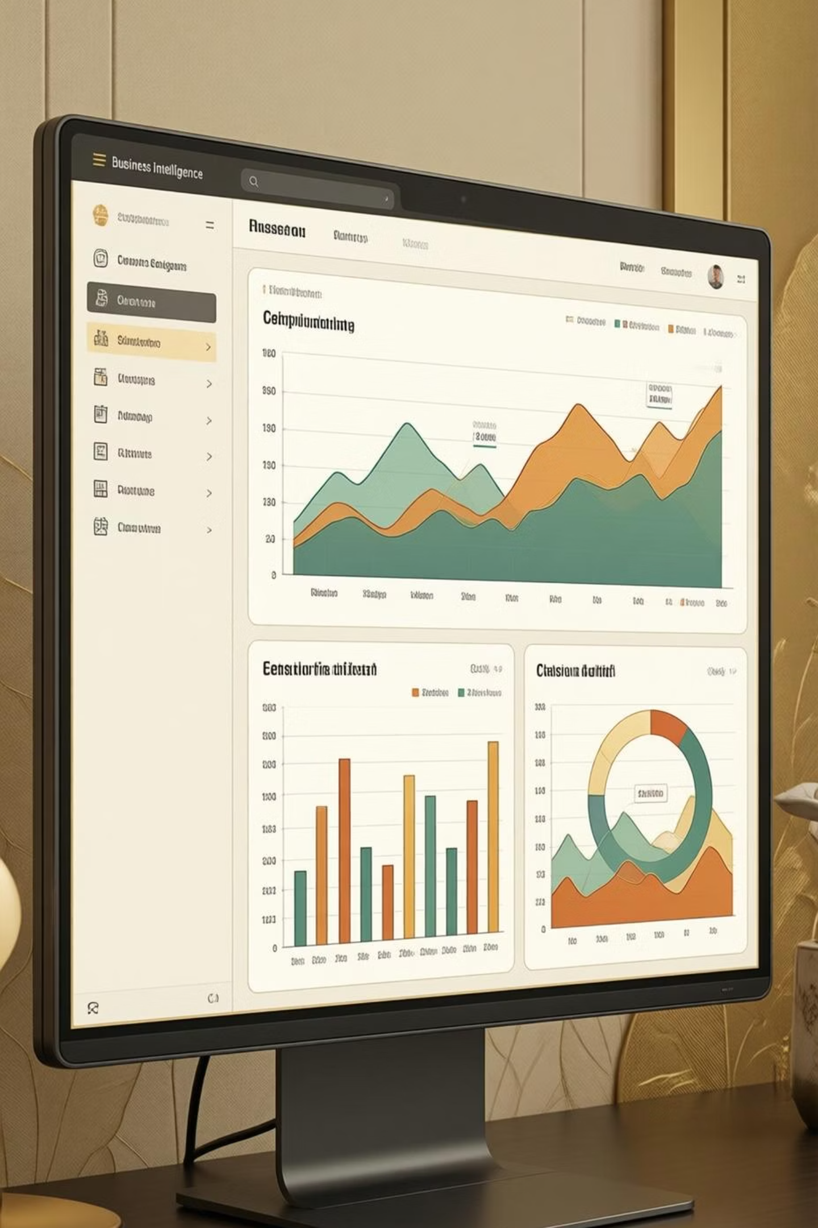
POWER BI
Interactive Dashboard
Real-time Filtering
Visual Insights
Subscription status, gender, category, shipping type
Revenue and sales by category, age group analysis
Key Metrics
3.9K customers, $59.76 avg purchase, 3.75 rating

Slide 10
RECOMMENDATIONS
Strategic Actions
Boost Subscriptions
Loyalty Programs
Review Discounts
Promote exclusive benefits - only 27% currently subscribed
Reward repeat buyers to grow loyal segment
Balance sales boosts with margin control
Targeted Marketing
Product Positioning
Focus on high-revenue age groups and express shipping users
Highlight top-rated items in campaigns

